Slide 1
Press Energy Services, LLC
Spill Protection/Prevention

Slide 2
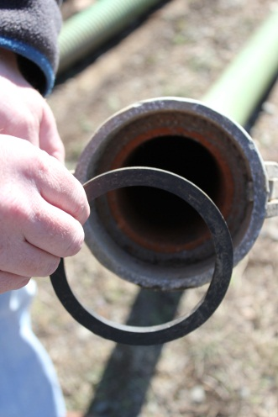
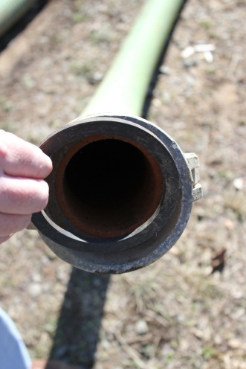
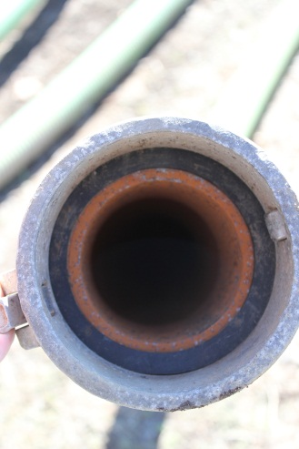
Drivers
Must be properly trained on valves and connections
Must know how to properly operate pumps
Be aware of task at hand
Ensure gaskets in place properly
Inspect Camlocks for integrity

Slide 3
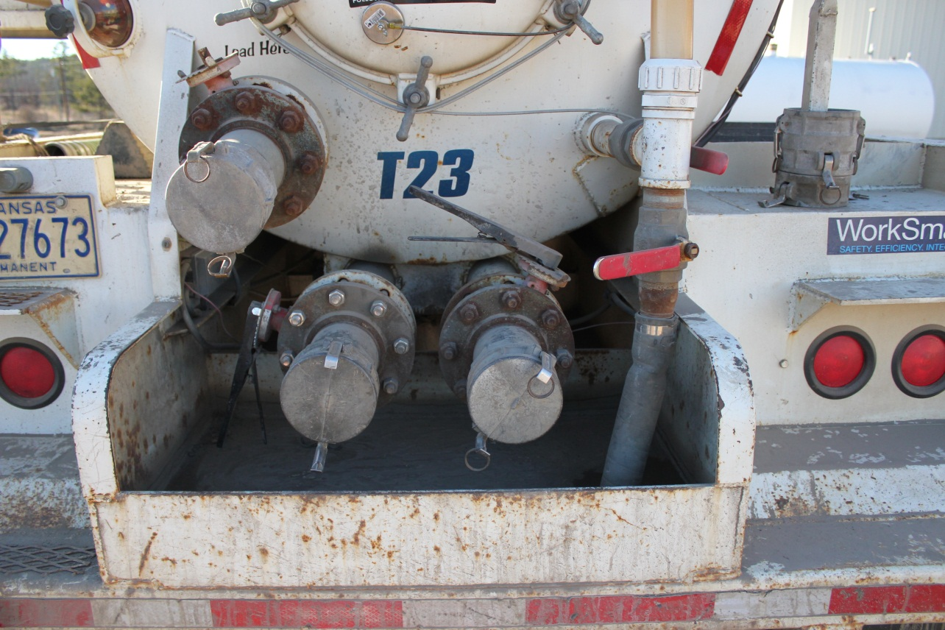
Valve Buckets
Buckets placed under valves to capture potential leaks from valves

Slide 4
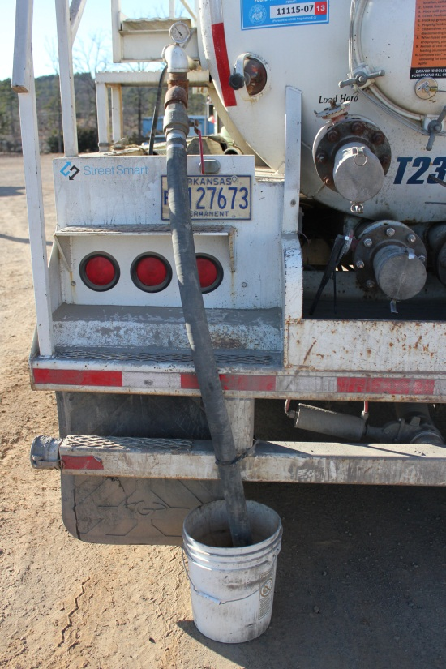
Pressure Release Valves

Slide 5
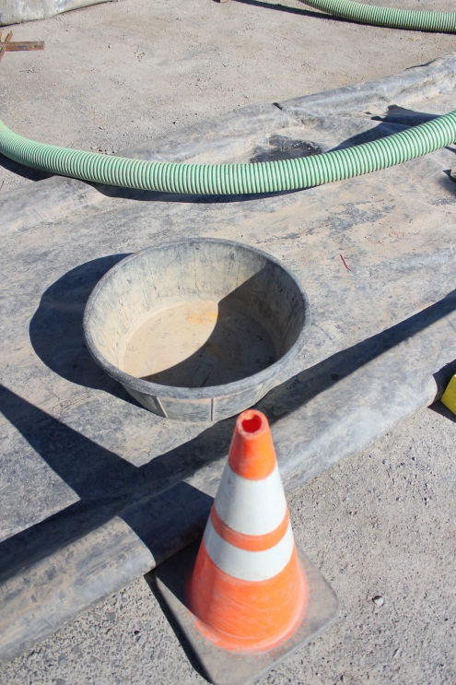
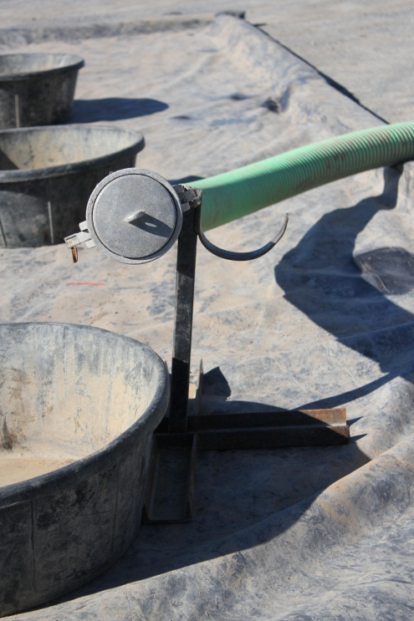
Spill Prevention Tools

Slide 6
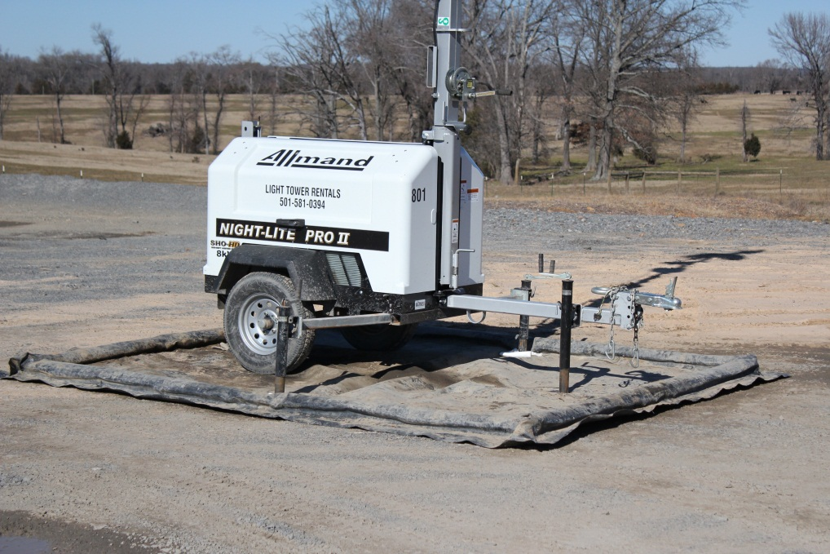
Spill Containment Berms

Slide 7
Spill Procedures
In event of spill:
Properly contain the leak source
Notify Management immediately
Remove any soil in affected area and place in bucket
Appropriate disposal of soil at yard

